Slide 1
Spending habit survey
Roli Srivastava

Slide 2


Slide 3
Project Overview
Over the last couple of years, we have seen the usage of internet increase exponentially.
People of all ages are surfing the internet on various types of devices
The big question arises – does this impact day to day life?
One of the aspects of life that we are going to explore is spending habits as internet has made spending money easier. Example - Amazon
As one spends more time on the internet, they are exposed to more advertisements, websites, fashion trends etc. and our hypothesis is that this exposure affects spending habits
Apart from internet usage do demographics plays any vital role in spending habits.

Slide 4
Research Question:
1.Does Internet Usage Influence Spending Habits?
2.Does Demographics Influence Spending Habits?

Slide 5
Significance of Research
If we can establish a relationship between internet usage and spending habit, then -
Internet heavy advertisement plans may be the best way to go for businesses
It can be used to educate young people about making smart financial decision
It can also be used to educate parents on how their children's spending habit may be forming without their understanding
Establishing this relationship maybe helpful in understanding the trend of where we are headed as technology continues to advance

Slide 6
Methodology
Descriptive statistics to analyze the type of data
Ord_plots
Distplot
Relationship studies
Chi Square Test
CMHtest
Assocstats
Regression
Tools used: R

Slide 7
The Data
The data set from Kaggle
It includes 1010 responses from young people who were asked to rank their preferences on various topics
The variables in order Strongly disagree 1-2-3-4-5 Strongly agree (integer) : Ranked data
SPENDING HABITS
I enjoy going to large shopping centers. Shopping.centres
I spend a lot of money on partying and socializing. Entertainment.spending
I spend a lot of money on my appearance. Spending.on.looks
I spend a lot of money on gadgets. Spending.on.gadgets
I will happily pay more money for good, quality or healthy food. Spending.on.healthy.eating

Slide 8
The Data
Internet usage less than an hour day - few hours a day - most of the day – no time at all (categorical)
DEMOGRAPHICS
Age: (integer)
Height: (integer)
Weight: (integer)
Gender: Female - Male (categorical)
Highest education achieved: Primary school - Secondary school - Bachelor degree (categorical)
I am the only child: No - Yes (categorical)
I spent most of my childhood in a: City - village (categorical)
I lived most of my childhood in a: house/bungalow - block of flats (categorical)

Slide 9
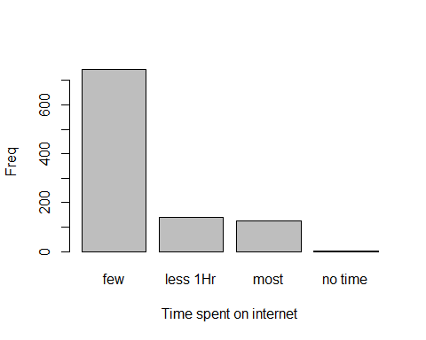
Analysis for internet usage

Slide 10
Goodness of fit for binomial & Poisson for internet usage
summary(goodfit(SurveyData$Internet.usage, type="binomial"))
X^2 df P(> X^2) ## Likelihood Ratio 755.4354 2 9.105325e-165
Shows lack of fit.
summary(goodfit(SurveyData$Internet.usage, type="poisson"))
## X^2 df P(> X^2) ## Likelihood Ratio 976.6713 2 8.289401e-213
Conclusion: Lack of fit.

Slide 11
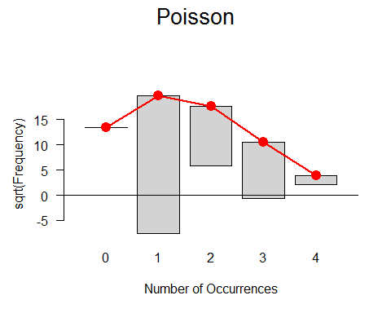
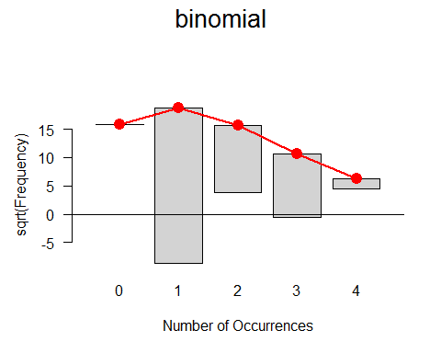
plots – Poisson seems to fit better

Slide 12
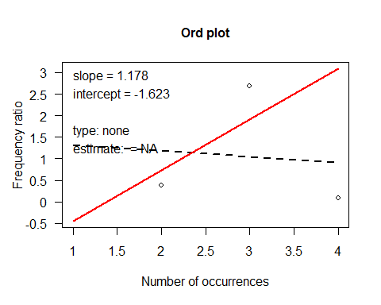
OrdPlot

Slide 13
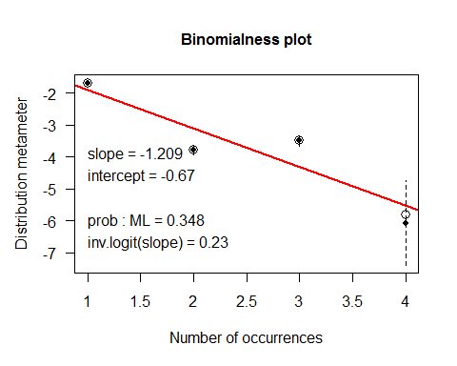
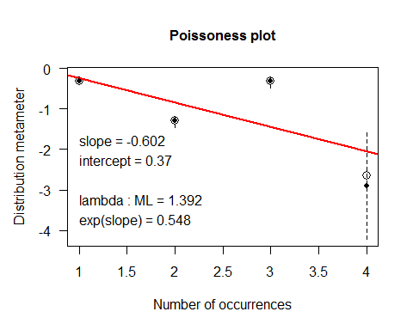
Dist Plot
Notes:
looks like fits poisson better than binomial

Slide 14
Association Analysis – Chi Square test
Between internet usage and entertainment spending
surveyEnt <- ftable(xtabs(~Internet.usage + entertainment, data = SurveyData )) chisq.test(surveyEnt)
## ## Pearson's Chi-squared test ## ## data: surveyEnt ## X-squared = 29.444, df = 12, p-value = 0.003384
# significant relation
Like wise this test was done for kinds of spending looks, gadgets, healthy eating
It was only found significant for the gadgets and not for looks and healthy eating

Slide 15
Association Analysis – Cochran-Mantel-Haenszel tests
CMHtest(surveyGadgets)
## Cochran-Mantel-Haenszel Statistics ## ## AltHypothesis Chisq Df Prob ## cor Nonzero correlation 4.071 1 4.3626e-02 ## rmeans Row mean scores differ 29.237 3 1.9965e-06 ## cmeans Col mean scores differ 16.389 4 2.5396e-03 ## general General association 51.848 12 6.5965e-07
Looks like it is significant for gadgets as shown in chi square test earlier.
It was also found significant for entertainment but not for looks and healthy eating

Slide 16
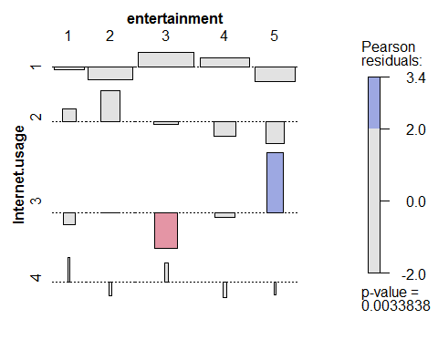
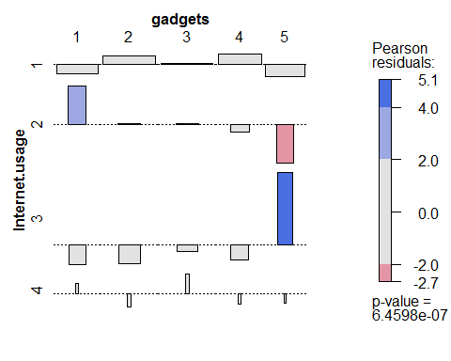
Association Analysis –assoc plots
vcd::assoc(surveylooks, shade=TRUE)
Notes:
Significant for both entertainment and gadgets

Slide 17
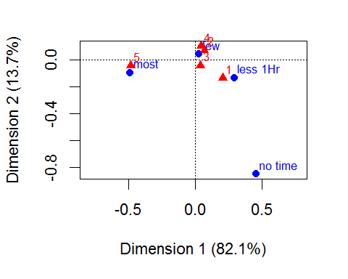
correspondence analysis
For Gadgets it shows that people who strongly agreed spending on gadget and rated as 5 use to spend most time on internet.

Slide 18

Regression Modeling

Slide 19
Modeling – linear model Regression
We made a fuller model with all spending but than reduced as it was significant only for gadgets and look.
lm(formula = Internet.usage ~ entertainment + eating + gadgets + ## looks, data = SurveyData, family = "poisson")
## Coefficients: ## Estimate Std. Error t value Pr(>|t|) ## (Intercept) 1.44500 0.09483 15.238 <2e-16 *** ## entert 0.02138 0.02106 1.015 0.3103 ## eating -0.03545 0.02127 -1.666 0.0960 . ## gadgets 0.05028 0.01915 2.625 0.0088 ** ## looks -0.04558 0.02097 -2.174 0.0299 *
## Multiple R-squared: 0.01295, Adjusted R-squared: 0.008991 ## F-statistic: 3.27 on 4 and 997 DF, p-value: 0.01123
Notes:
Not very high R values . It shows that for every unit increase in spending on gadgets internet usage increase by 0.05
It shows that for every unit increase in spending on looks internet usage decreases by 0.04

Slide 20
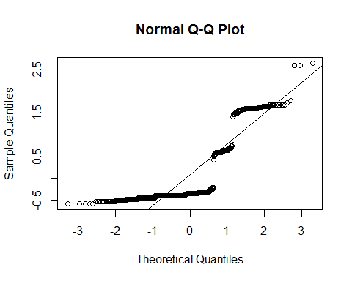
Multicollinearity & Residual Plots
vif(model1)
## entertainment eating gadgets looks ## 1.265751 1.092040 1.224228 1.292038
shapiro.test(model2$residuals) W = 0.66549, p-value < 2.2e-16
Notes:
No Multicollinearity found none of the square of each are higher than the 10. So it looks fine. Residual plot does not look good and shapiro is also significant.

Slide 21
Modeling via logistic Regression
survey.logistic2 <- glm(Internet.usage ~ gadgets + looks + entertainment + eating, data=SurveyData, family=poisson)
coeftest(survey.logistic2)
## Estimate Std. Error z value Pr(>|z|) ## (Intercept) 0.36651 0.11374 3.222 0.00127 ** ## gadgets 0.03596 0.02301 1.563 0.11815 ## looks -0.03253 0.02522 -1.290 0.197152 ## entert 0.01518 0.02536 0.599 0.54944 ## eating -0.02518 0.02550 -0.987 0.32346
Nothing significant

Slide 22
OddsRatio
exp(cbind(OddsRatio=coef(survey.logistic2), confint(survey.logistic2)))
OddsRatio 2.5 % 97.5 % ## (Intercept) 1.4426871 1.1526391 1.800238 ## gadgets 1.0366117 0.9908693 1.084412 ## looks 0.9679975 0.9213521 1.017093 ## entert 1.0152952 0.9660526 1.067020 ## eating 0.9751335 0.9277109 1.025258
Thus, for a gadgets, the odds of spending on gadgets are 1.03 times as large as the odds of internet usage increases.

Slide 23
Analysis of spending habit based on demographics.
Spending on gadgets based on demographics
model <- polr(gadgets ~ Gender + Education + Age + Only.child + Village_town + building, data = SurveyData, Hess = TRUE, method = "logistic") coeftest(model)
## buildingblock of flats 0.009154 ** ## buildinghouse/bungalow 0.009673 ** Only impacted by if person lives in flats or bungalow

Slide 24
Analysis of spending habit based on demographics.
Spending on entertainment based on demographics
model <- polr(entertainment ~ Gender + Education + Age + Only.child + Village_town + building, data = SurveyData, Hess = TRUE, method = "logistic") coeftest(model)
## Only.childno < 2e-16 *** ## Only.childyes < 2e-16 *** ## buildingblock of flats 0.03022 * ## buildinghouse/bungalow 0.02985 * Only impacted by if person lives in flats or bungalow and also if only child or not

Slide 25
Analysis of spending habit based on demographics.
Spending on looks based on demographics
model <- polr(looks ~ Gender + Education + Age + Only.child + Village_town + building, data = SurveyData, Hess = TRUE, method = "logistic") coeftest(model)
## Only.childno <2e-16 *** ## Only.childyes <2e-16 *** Only impacted by if only child or not

Slide 26
Analysis of spending habit based on demographics.
Spending on eating based on demographics
model <- polr(eating ~ Gender + Education + Age + Only.child + Village_town + building, data = SurveyData, Hess = TRUE, method = "logistic") coeftest(model)
looks like spending on eating is non impacted by any of them

Slide 27
Conclusion
Most of the young people spend few hours a day on internet
the ord ,dist and assoc that the data fit the Poisson distribution
the chiq-test and CMH relationship tests were significant only for spending on entertainment and gadgets with internet usage
Through our model we saw that gadgets and looks are the two main criteria for spending time on internet where looks was oppositely signified.
For the demographic part – spend on gadgets impacted by person lives in flats or bungalow
spend on entertainment impacted by person lives in flats or bungalow or only child/not
spend on looks impacted by person is only child/not

Slide 28
Gaps and Future Efforts
This data was not sufficiently able to infer internet usage based on just on spending , may be there are other factors which impacts the internet usage.
Like many people spend time on gaming and that impacts internet usage so need such of more data to get to the root cause.
If internet usage - was collected in continuous variable in time that could have given better picture.

Slide 29
References
https://www.statmethods.net/graphs
https://stat.utexas.edu/videos/r/statistical-inference

Slide 30

Thank You!

